Slide 1

CREDIT CARD DEFAULT PREDICTION
ELSI SAHAYA RENITA.L

Slide 2
Problem Statement:
Financial threats are displaying a trend about the credit risk of commercial banks as the incredible improvement in the financial industry has arisen. In this way, one of the biggest threats faced by commercial banks is the risk prediction of credit clients. The goal is to predict the probability of credit default based on credit card owner's characteristics and payment history.
About Dataset:
This dataset contains information on default payments, demographic factors, credit data, history of payment, and bill statements of credit card clients in Taiwan from April 2005 to September 2005.

Slide 3
Tools used
Pandas
Numpy
Seaborn
Matplotlib
SKLearn

Slide 4
APPROACHES
Data Cleaning
Exploratory Data Analysis (EDA)
Correlation
Splitting the dataset
Machine Learning Model Building
Selecting Best Model
Feature Importance
Model Testing

Slide 5
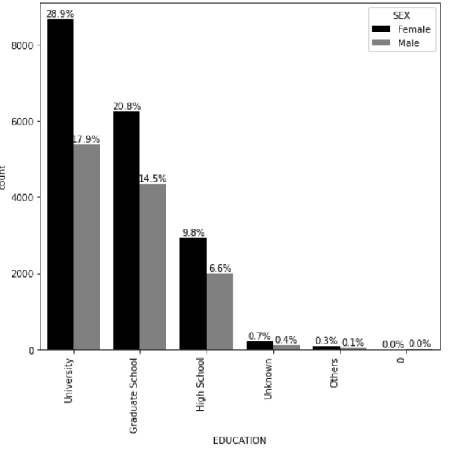
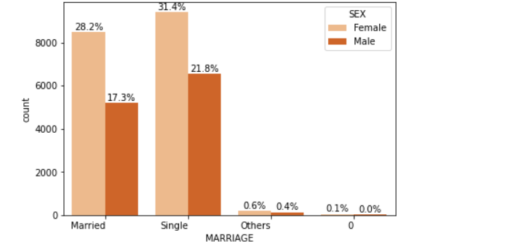
EDA INSIGHTS
In the given dataset Female plays high priority in every aspects such as Education and Marriage compared to Male.

Slide 6
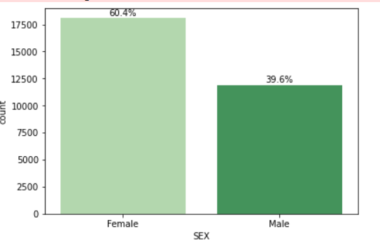
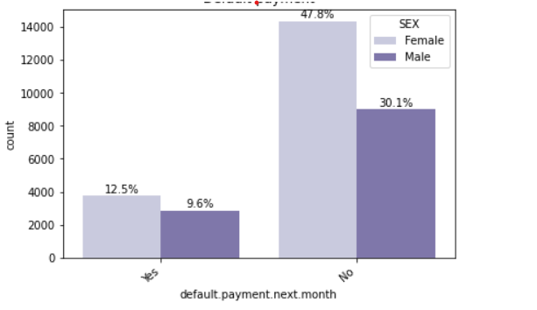
Default payment vs sex
From the graph, it is evident that the Males are more expected to default compared to Females. Also Female plays important role in the dataset than Male.

Slide 7
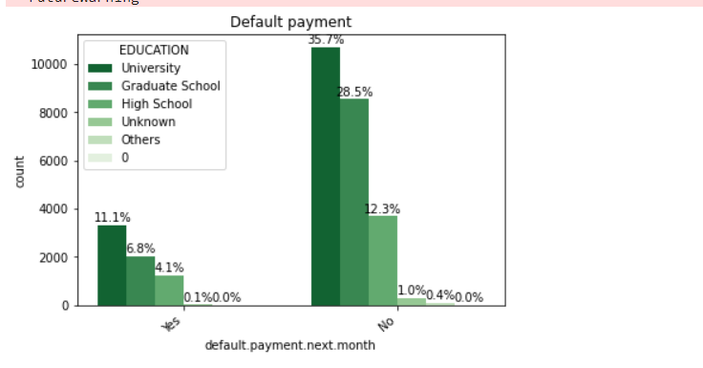
Default payment vs Education
Non default payment has
higher percentage
compared to default payment.
In both aspects University
holds the high priority
whereas Unknown category plays
neutral.

Slide 8
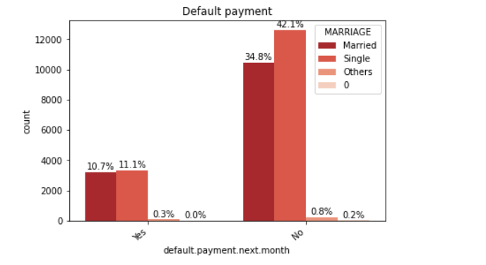
DEFAULT PAYMENT VS MARRIAGE
In Non Default Payment Single has
higher percentage,
mostly singles are aware of
default Credit card Payment.
Also Single has slightly
higher percentage in
default payment in next month.

Slide 9
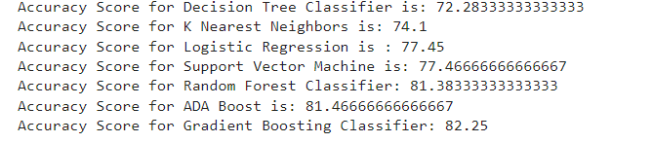
MACHINE LEARNING MODEL
As the given dataset falls under Classification Problems, thus mostly Classifications Algorithm are used, such as Logistic Regression, K Nearest Neighbors, Decision Tree Classifier, Support Vector Machine, ADA Boost Classifier, Gradient Boosting Classifier, and Random Forest Classifier. Based on Accuracy Score Gradient Boosting Classifier has been taken as Best Machine Learning Model to predict the target.

Slide 10
Evaluation Metrics of Model
Evaluation Metrics that have been used in the given datasets are as follows
accuracy_score
classification_report
confusion_matrix

Slide 11
FEATURE IMPORTANCE
Finally the best model based on the accuracy score has been chosen as the Gradient Boosting Classifier Feature importance has been executed to find out the best features which have strong correlation with the Target the most and thus the features which provide less contribution has been removed.
Initially, there were 24 features and finally only 8 features has strong and positive correlation that are used to predict the Target.

